Slide 1


ESA PBL REVIEW

Slide 2
SAYOOJ S | 2310040132
VENKAT PRASAD | 2310040076
SAITEJA | 2310040089
RAVI RATNA | 2310040132
Student Name
Student Roll numbers

Slide 3
Problem Statement
With the growing need for enhanced security and remote monitoring in residential and commercial spaces, there is a demand for cost-effective, easily deployable, and intelligent surveillance solutions. Traditional security systems, such as physical keys, RFID-based access, and biometric authentication, often lack real-time monitoring capabilities and remote access control. Existing surveillance solutions may also be expensive, complex to install, or limited in their ability to provide instant updates
.Methadology
To address these challenges, there is a need for an IoT-enabled surveillance system that can capture and transmit real-time visual data on demand, providing instant alerts to users through a user-friendly interface, such as a Telegram chatbot. This system should be designed for affordability, ease of deployment, and privacy-conscious operation, ensuring secure data transmission while maintaining ethical use and compliance with data protection regulations.

Slide 4
Introduction to ESP32-CAM Module
ESP32-CAM
Features
The ESP32-CAM is a low-cost, versatile microcontroller with an integrated camera sensor.
It includes built-in Wi-Fi and Bluetooth connectivity, making it ideal for IoT applications.

Slide 5

Connecting ESP32-CAM to a Telegram Chatbot
Telegram Bot API
ESP32-CAM
Use the Telegram Bot API to communicate with the chatbot.
Program the ESP32-CAM to send image data to the chatbot.

Slide 6

Programming the ESP32-CAM for Image Capture
1
Initialize the camera sensor.
2
Capture an image using the camera driver.
3
Convert the image to a suitable format for transmission.

Slide 7
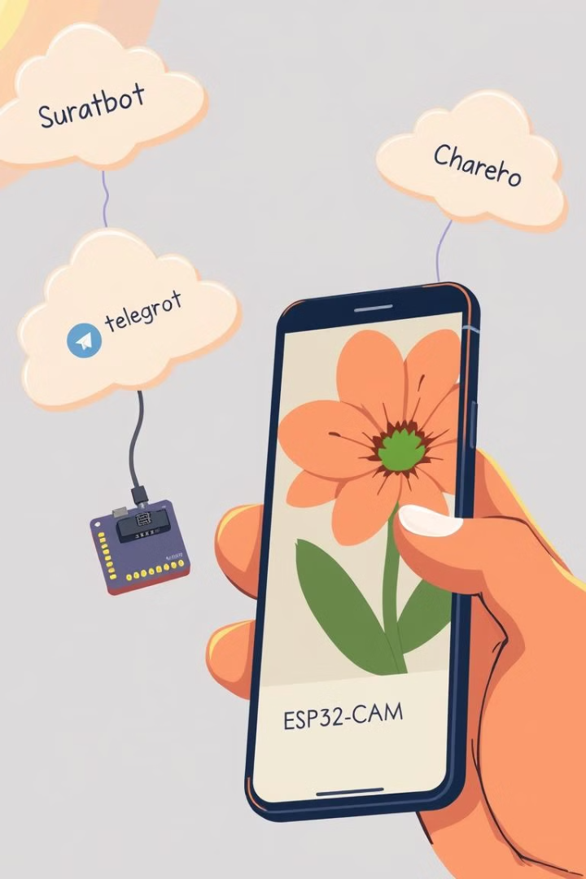


Sending Images to the Telegram Chatbot
Connect to the Telegram Bot API using the obtained token.
Send the captured image data to the chatbot using an HTTP request.

